Slide 1
Mura - No more mystery
Introduction
Scott Hong
10/07/2019

Slide 2
Mura : no more mystery
Background
Almost every Echo Show suffered by Mura during development
Objective
We can fix the Mura problem ( X )
We narrowed down the root cause of Mura ( Δ )
We can measure the Mura to get quantitative data ( O )

Slide 3
Mura : no more mystery
Introduction
Activities is Crown development – Haiwei Chen
pDOT analysis of Mura – Matt Little
Machine leaning algorithm for Mura evaluation – Ahmed Hassan
Mura test fixture – Ming Wang

Slide 4
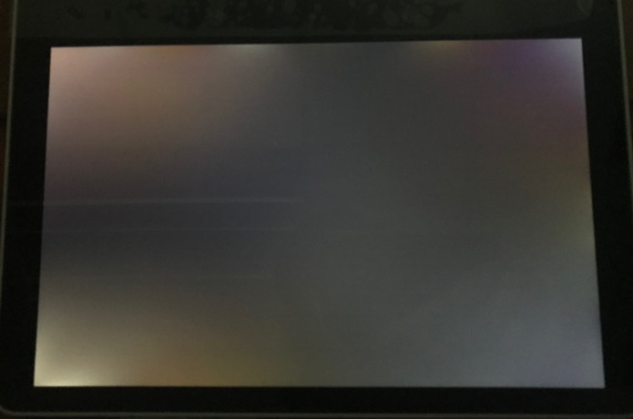
Typical Mura symptom

Slide 5
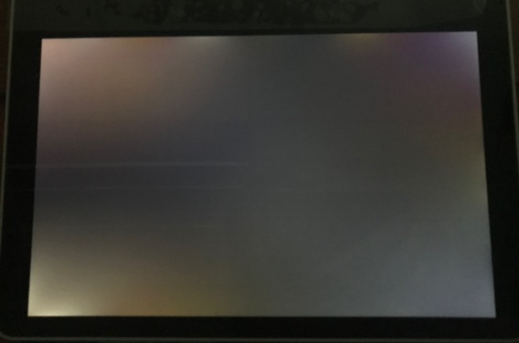
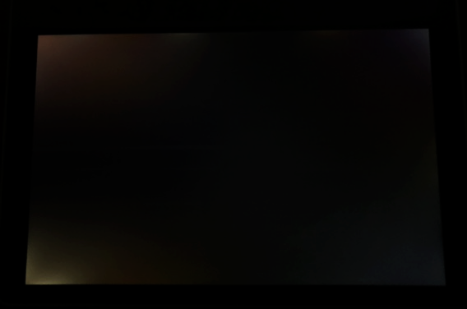
Typical Mura symptom - realistic
Camera auto exposure
Realistic image to human eyes

Slide 6
Visible condition of Mura
Mura is not visible when
the room is bright
ALS adjust the brightness of backlight in dark environment
any image other than solid black (+ gray clock) is on
Mura is not a functional defect, but has impact on the reputation

Slide 7
The origin of the name of “Mura”
Mura (むら, 斑) : unevenness or stain in Japanese
Yellow mura, suji mura, COG mura, red eye mura, Corner mura, ...
Different names are used for our symptom
Corner Mura
Stress Mura
Light leakage
Mura
Mura
Light leakage
COG mura
Stress mura
COG mura
Yellow mura
Yellow mura
Suji mura
Suji mura

Slide 8
Yellow Mura vs White (stress) Mura
Yellow Mura : LCD on (white image)
Liquid crystal : bigger optical dispersion (wavelength dependency) makes color change
Cell gap makes the LC thickness changed
White Mura : LCD off (black image)
Glass : smaller optical dispersion makes same polarization rotation across RGB
Cell gap has no relation with white mura in black image
Liquid crystal
Column spacers
Polarizer
CF glass
Cell gap
TFT glass
Polarizer

Slide 9
The cause or light leakage – polarization rotation in glass
White image
Black image
Light leakage
↔︎
↔︎
Column spacers
Liquid crystal
Polarizer
Polarizer
↔︎
Polarizer
↔ ︎
︎
CF glass
CF glass
CF glass
◉ ↔︎
◉
◉ ↔︎
◉ ↔︎
Cell gap
◉
◉ ↔︎
TFT glass
TFT glass
TFT glass
◉ ︎
◉
◉ ↔︎
Polarization rotation
by retardation
◉
◉
Polarizer
Polarizer
◉
Polarizer
◉ ↔︎
P-polarization
◉ ↔︎
S-polarization
◉ ↔︎
Backlight

Slide 10







The cause of polarization rotation – glass retardation
Bending induces stress
Stress induces birefringence of glass
Push
No stress
Under stress
n_{i}
n_{e}
n_{i}
n_{o}
Glass
Tensile stress
$$n_{e}≠n_{o}$$
d
anisotropic
isotropic
Compressive
stress
$$n_{e}−n_{o}=CB × (σ_{11}−σ_{22})$$
$$R=\left(n_{e}−n_{o}\right) × d$$
$$n_{e} , n_{o} :Indices of refrection$$
$$CB :stress−optic coefficient$$
$$σ_{11}, σ_{22} :Principal stresses$$
$$R :retardation$$

Slide 11
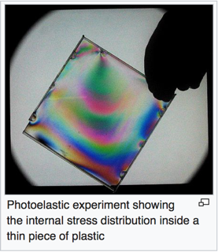
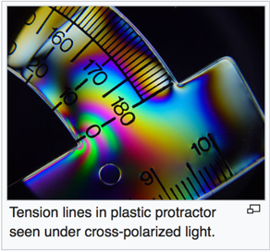
The cause of glass retardation – Photoelasicity
Photoelasticity
The changes in the optical properties of a material under mechanical deformation caused by the stress distribution
Setup for polariscope
→ Same as LCD stack-up

Slide 12
The cause of stress – (local) flatness of housing
External housing - curve at corner
Shrinkage of molded part
Result Mura modes

Slide 13
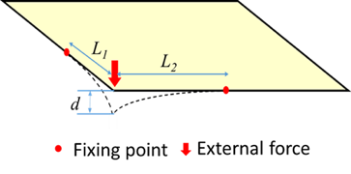
Bending test - Bishop
Setup
Result
L1 = L2 = 30mm
d > 0.4mm

Slide 14
Solutions of Mura in display industry
CNC cut from chunk of aluminum
+ $$$$$
Compensation of tools
+ Time
Thinning the LCD glasses
+ $$
In order to make the part flat,
the tool shouldn’t be flat

Slide 15
Mura : no more mystery
Introduction
Activities is Crown development – Haiwei Chen
pDOT analysis of Mura – Matt Little
Machine leaning algorithm for Mura evaluation – Ahmed Hassan
Mura test fixture – Ming Wang

